Slide 1




Basketball IV
Produced by Dr. Mario
UNC STOR 390

Slide 2
NBA Salaries
Recall Baseball Salary Estimation
Based on Value Over Replacement Player (VORP)
Defined Replacement Player as Bottom 20%
Assumed Replacement Player Costs $0
Team of Replacement Players Cost $0 (44-118 Record)
Average Team’s Salary was $77M (81-81 Record)
$77M Needed for Replacement Team to Get to Average
Application to NBA Salaries (Based off 2006-2007)
Average Team Payroll Was Approximately $66M
Minimum Player Salary $400,000
Define Replacement Player as Bottom 10% in WINVAL
WINVAL of Replacement Player = -6
Team of Replacement Players Lose to Average Team by 30 Points
Average Team Scores 98.7 Points Per Game

Slide 3
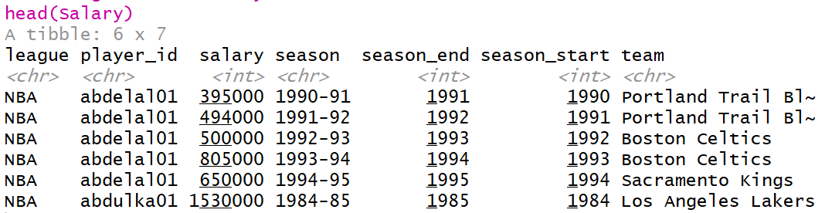
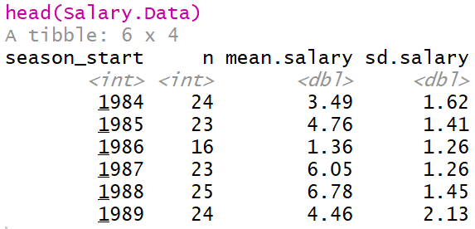
NBA Salaries
NBA Salary Information Across the Years
Data from Basketball-Reference.com
Data Preview
Salary Summarized by Season

Slide 4
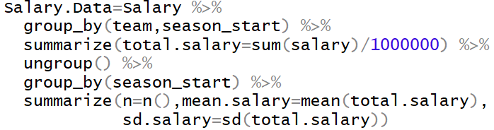
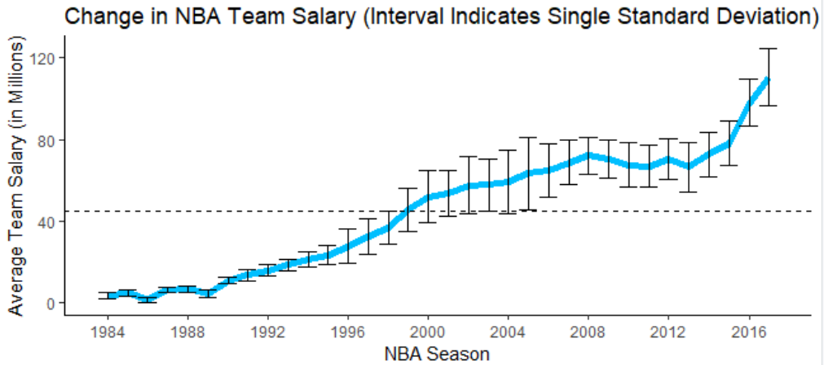
NBA Salaries
NBA Salary Information Across the Years
Code for Summary Table
Figure Showing Change
Textbook

Slide 5
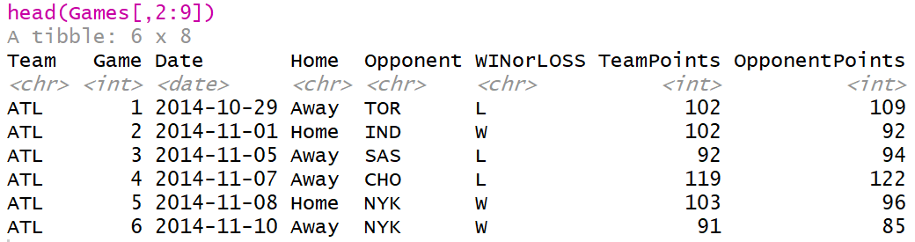

NBA Salaries
Pythagorean Theorem For Basketball
Modeling Win Percentage Using Points
From Textbook, α=13.91 Based on Data Before 2007
Question: Has This Result Stayed Consistent?
Data from 2014 to 2018 Found on Kaggle
$$Win \%≈\frac{{\left(\frac{Points Scored}{Points Allowed}\right)}^{α}}{{\left(\frac{Points Scored}{Points Allowed}\right)}^{α}+1}$$

Slide 6
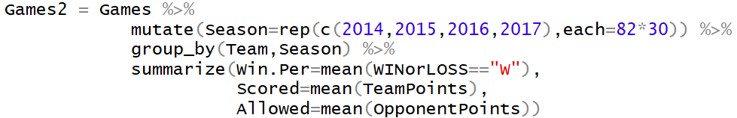
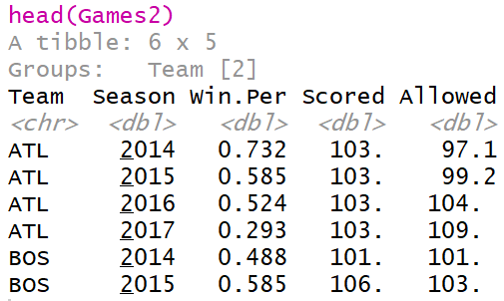
NBA Salaries
Pythagorean Theorem For Basketball
Modifying Data for Estimating α

Slide 7
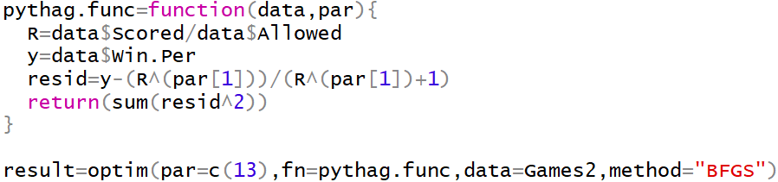

NBA Salaries
Pythagorean Theorem For Basketball
Minimize Sum of Squares (Predicted Win % Versus Actual Win %)
Based on Recent Data, Best α is 14.4564

Slide 8


NBA Salaries
Application of Pythagorean Theorem to Replacement Players
Losing 30 Points to Average Team Means Final Score 68.7 to 98.7
Winning Percentage for Team of Replacement Players
Expected Number of Wins for Team of Replacement Players
Team of Replacement Players Would Win 0 Games
Team of Average Players Would Win 41 Games
$$Win \%≈\frac{{\left(\frac{68.7}{98.7}\right)}^{14.4564}}{{\left(\frac{68.7}{98.7}\right)}^{14.4564}+1}=0.005282$$
$$Wins=\left(Win \%\right)×\left(82 Games\right)≈0.433$$

Slide 9
NBA Salaries
Cost of Winning (Based on Book)
Cost $2M to Get 0 Wins Over 82 Games
$2M is $64M Less Than the Average Salary (2006-2007)
Assumption: Costs $64M to Be Average
This Implies:
Criticism 1
Average Salary is not the Salary of an Average Team
Recommendation: Regress Salary on Wins and Predict When Wins = 41
Criticism 2
Team Salaries are Highly Skewed and Influenced by Outliers
Recommendation: Use Median
$$Price Per Win=\frac{\$64M}{41}=\$1,560,976$$

Slide 10
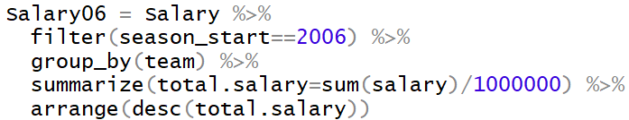
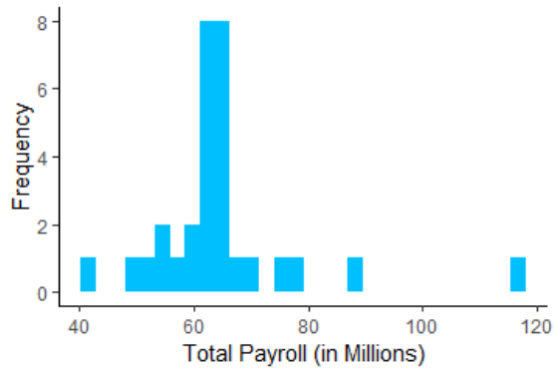
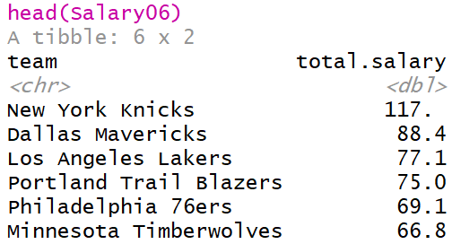
NBA Salaries
Visual of Team Payrolls
Team: New York Knicks
Payroll: $117M
Record: 33-49
Conclusion: Idiots

Slide 11
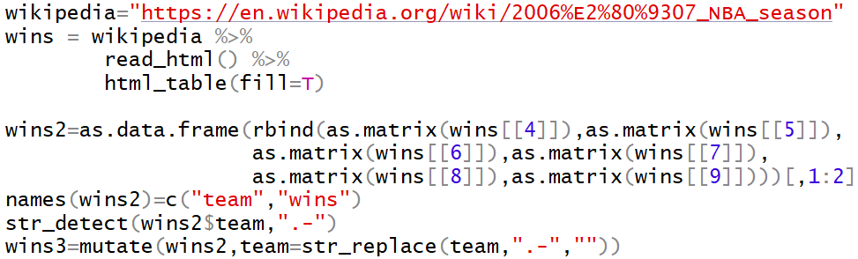
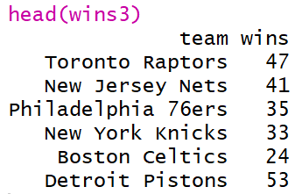
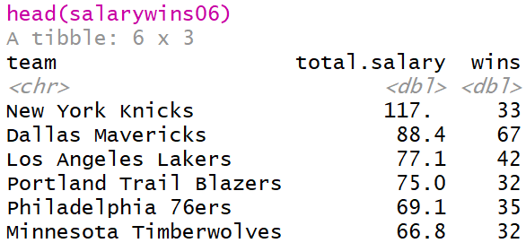
NBA Salaries
Getting Wins and Losses Into Data
Scraping Team Records From Wikipedia
Merging Datasets

Slide 12
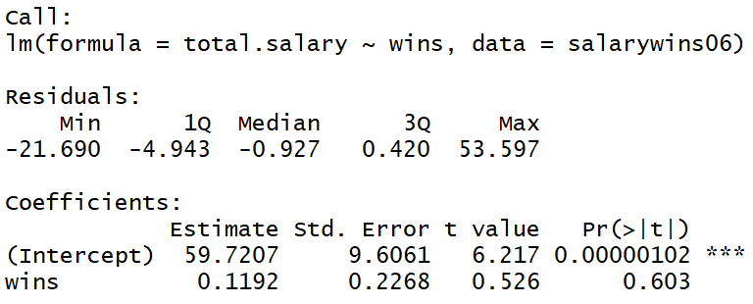
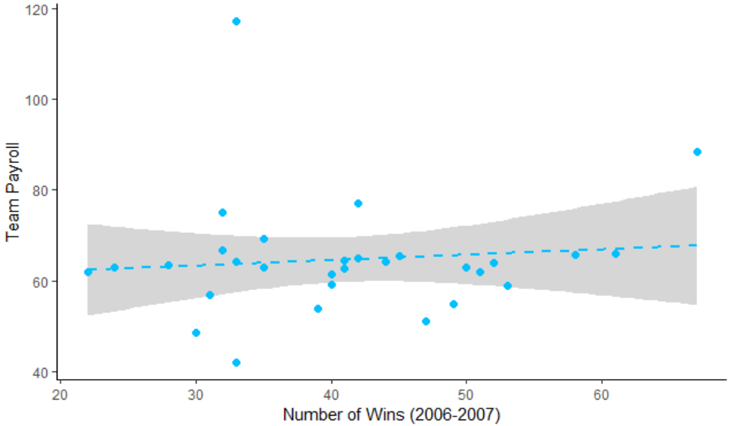
NBA Salaries
Fix Based on Criticism 1
Linear Regression Model and Fit
Prediction Under Linear Model is $64M for 41 Win Team
Assumption: Costs $62M to Be Average
This Implies:
$$Price Per Win=\frac{\$62M}{41}=\$1,512,195$$

Slide 13

NBA Salaries
Fix Based on Criticism 2
Median is Robust Against Outliers (NY Knicks)
Motivation: We Don’t Want One Stupid Team to Get Us to Overpay
Assumption: Costs $61M to Be Average
This Implies:
Points Over Replacement Player (PORP)
$$Price Per Win=\frac{\$61M}{41}=\$1,487,805$$
$$PORP=\left(Adjusted+/−\right)−\left(−6\right)=\left(Adjusted+/−\right)+6$$
Individual Player
Replacement Player

Slide 14
NBA Salaries
PORP for Average Team
For Average Player, PORP = 0+6 = +6 Points Per 48 Minutes
In a Season, There are 3,936 Minutes
For Team 5 Players, This Equates to 19,680 Minutes
For Team of 5 Average Players,
Scaled to Number of Games
Indicates the Following Conversion
$$PORP×Minutes=6×19,680=118,080$$
$$\frac{118,080}{41}=2,880 Per Win$$
$$2,880 PORP×Minutes Played=1 Win$$

Slide 15
NBA Salaries
Determining Fair Salary Based on PORP
Wins Generated by a Player (W)
Fair Salary (SAL)
We Found 3 Different Choices for Dollars Per Win
$1,560,976
$1,512,195
$1,487,805
$$W=\frac{PORP×Minutes Played}{2,880}$$
$$SAL=W×Dollars Per Win$$

Slide 16
NBA Salaries
Example: King James in 2006-2007
Played 3,190 Minutes and Had an Adjusted +/- of 14.412 Per 48 Minutes
Therefore Lebron James Had a PORP of 20.412
Wins Generated by Lebron James
Fair Salary for Lebron James
$$W=\frac{20.412×3,190}{2,880}=22.6$$
Method | Wins | Price Per Win | Fair Salary
Book | 22.6 Wins | $1,560,976 | $35.3M
Regression | 22.6 Wins | $1,512,195 | $34.2M
Median | 22.6 Wins | $1,487,805 | $33.6M

Slide 17

Final Inspiration
There is no “I” in team,
but there is in win.
- Michael Jordan

